Slide 1

SPEECH EMOTION RECOGNITION USING MACHINE LEARNING
BATCH NO. 16 Gishnu Govind(1BG18CS406) Nayan Surya N(1BG18CS414) Santhosh A(1BG18CS422)
Monish K(1BG17CS051) UNDER THE GUIDANCE OF PROF. SAJITHA N ASST PROFESSOR DEPT OF CSE
Machine Learning

Slide 2
INTRODUCTION
Speech is the fast and best normal way of communicating amongst humans.
Computer should have enough knowledge to identify human voice and speech. Although there is a significant improvement in speech recognition.
The recognition of emotional speech aims to recognize the emotional condition of an individual utterer by applying his/her voice automatically.

Slide 3
[1] "Speech based human emotion recognition using MFCC“ by M. S. Likitha , S. R. R. Gupta, K. Hasitha and A. U. Raju, International Conference on Wireless Communications, Signal Processing and Networking (WiSPNET), Chennai, 2017.
Agenda Style
Facial expression based emotion classification enhances the fluency, accuracy, and genuineness of an interaction. This type of classification approach is very useful in interpreting human-computer interaction. Feature modeling and classification accuracy are strongly related to each other.
Advantages
Detecting faces based on the relationships between neighboring regions.
For videos, investigation and combination are done by both spatial and temporal features into a unified model.
Disadvantage
Some features would be taken more than once and some would be negligible.
LITERATURE SURVEY

Slide 4
[2] “An Introduction to Sampling Theory.” by Thomas Zawistowski & Paras Shah
Agenda Style
The signals we use in the real world, such as our voices, are called "analog" signals. To process these signals in computers, we need to convert the signals to "digital" form.
When the signal is converted back into a continuous time signal, it will exhibit a phenomenon called aliasing.
Advantages
It is easy to see the effects of changing the sampling frequency by looking at these transform plots.
Disadvantages
sampling frequency do not improve the quality of the reconstructed signal.
higher sampling frequencies require faster converters and more storage.
LITERATURE SURVEY

Slide 5
PROBLEM STATEMENT
Design and develop an application for Speech Emotion Recognition using machine learning technique.
The main elements for speech emotion recognition system are same as they are for any classic pattern recognition system.

Slide 6
WORKING PRINCIPLE:
methodology:
Sampling: Sampling is the first and important step of signal processing. Signals which we used normally, are all analog signals I.E. Continuous time signals. Therefore, for processing purpose in computer, discrete signals are better. In order to convert these continuous time signals to discrete time signals, sampling is used.
Pre-emphasis: The input signal often has certain low frequency components which will result in samples similar to their adjacent samples. These parts represent a slow variation with time and hence are not of any importance while extracting signal information. Therefore, we are performing pre-emphasizing by applying a high pass filter on the signal in order to emphasize the high frequency components which represent the rapidly changing signal.

Slide 7
De-silencing: Audio signals often contain regions of absolute silence occurring at the beginning or at the end and sometimes in between higher frequencies. It is required to remove this unwanted part from the signal and hence de-silencing is performed.
Framing: For the purpose of analysis, observable stationary signal is preferable. If we observe the speech signal on a short time basis, we are able to get a stationary signal. We divide the input signal into small constituent frames of a specific time interval.
Windowing: Most of the digital signals are large and infinite that they cannot be analyzed entirely at the same time. For better statistical calculations and processing, values of signal at each point should be available. In order to convert large digital signal into a small set for processing and analyzing, and for smoothing ends of signal, windowing is performed.

Slide 8
DESCRIPTION OF THE DATASET
THE DATASET contain audiovisual recordings of speakers in North American English. The RAVDESS consists of 24 professional actors, each performing 104 unique vocalizations with emotions that include: happy, sad, angry, fearful, calm, and neutral.
Each RAVDESS file has a unique filename. The filename consists of seven two-digit numerical identifiers, separated by hyphens (e.g., 02-01-06-01-02-01-12. mp4). Each two-digit numerical identifier defines the level of a different experimental factor.
For example, the filename “02-01-06-01-02-01-12.mp4” refers to: AUDIO-only (02)–Speech (01)–Fearful (06)– Intensity normal.

Slide 9
SYSTEM DESIGN: EXISTING SYSTEM
The first step is data collection, The model being developed will learn from the data provided to it and them results are guided by the data
The second step, called feature engineering, is a collection of several machine learning tasks that are executed over the collected data
The third step is where an algorithmic based model is developed. This model uses ML algorithms to learn about the data and train itself to respond to it
The final step is to evaluate the functioning of the built model. Comparison results help to choose the most accurate algorithm

Slide 10
SYSTEM DESIGN: PROPOSED SYSTEM
The proposed system consist 3 stages – speech signal acquisition, emotion pattern classification and the calculation of index with mobile agent
A speech signal is first picked up by the microphone of the cellular phone and then transmitted to the emotion recognition server
Then the queried speech is classified with confidence probability and the classification result will be reported and transmitted to the mobile agent, based on the probability of emotion classification

Slide 11
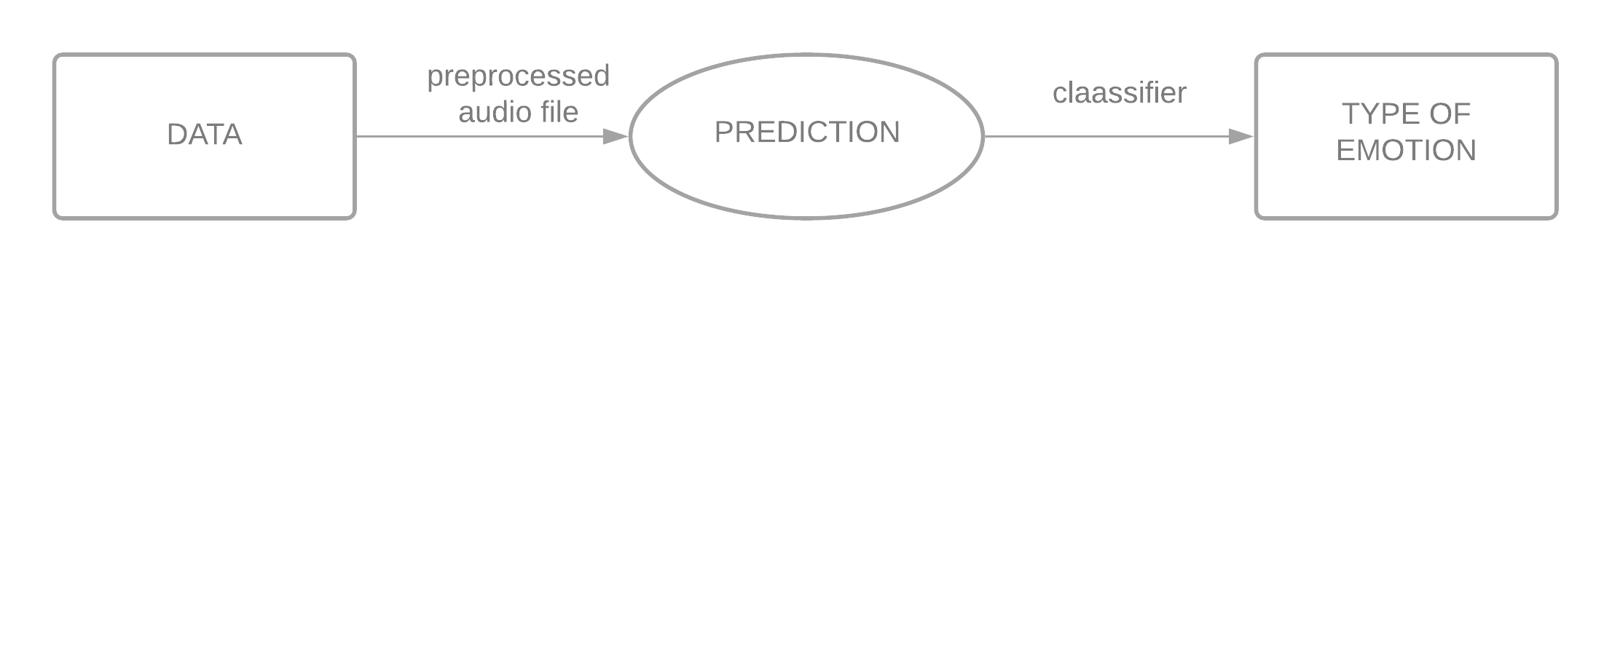
DATAFLOW DIAGRAM LEVEL - 0

Slide 12
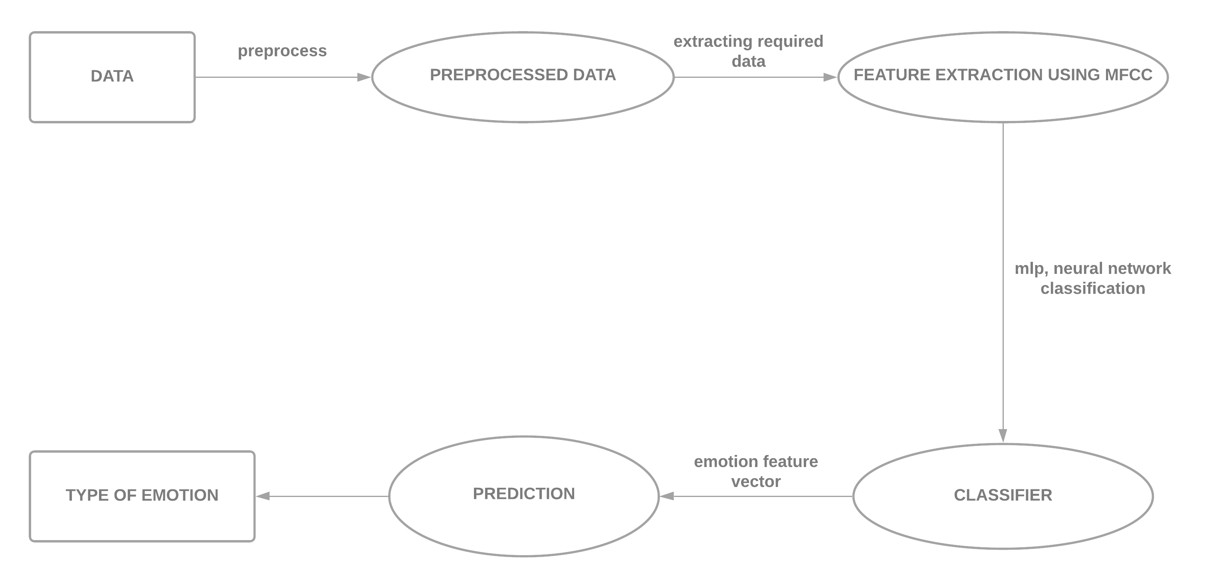
LEVEL - 1

Slide 13
TEST CASES
TEST CASE | UNIT TESTING
TEST NAME | PREDICTION
ITEMS BEING TESTED | PREDICT
SAMPLE INPUT | ACCURATE EMOTIONS(AUDIO)
EXPECTED OUTPUT | EMOTION RECOGNITION IS DONE BASED ON THE INPUT FILES.
ACTUAL OUTPUT | SUCCESSFUL SPEECH EMOTION RECOGNITION
REMARKS | PASS
01

Slide 14
TEST CASE | INTEGRATION TESTING
TEST NAME | PREDICTION
ITEMS BEING TESTED | PREDICT
SAMPLE INPUT | INCORRECT AUDIO FILES
EXPECTED OUTPUT | INACCURATE EMOTIONS DISPLAYED ON INVALID AUDIO FILES
ACTUAL OUTPUT | EMOTION RECOGNITION UNSUCCESSFULL
REMARKS | PASS
02

Slide 15
TEST CASE | SYSTEM TESTING
TEST NAME | SYSTEM TESTING IN DIFFERENT OS
SAMPLE INPUT | EXECUTE THE PROGRAM IN WINDOWS AND macOS
EXPECTED OUTPUT | EQUALL PERFORMANCE IN BOTH WINDOWS AND macOS
ACTUAL OUTPUT | SAME AS EXPECTED OUTPUT
REMARKS | PASS
03

Slide 16
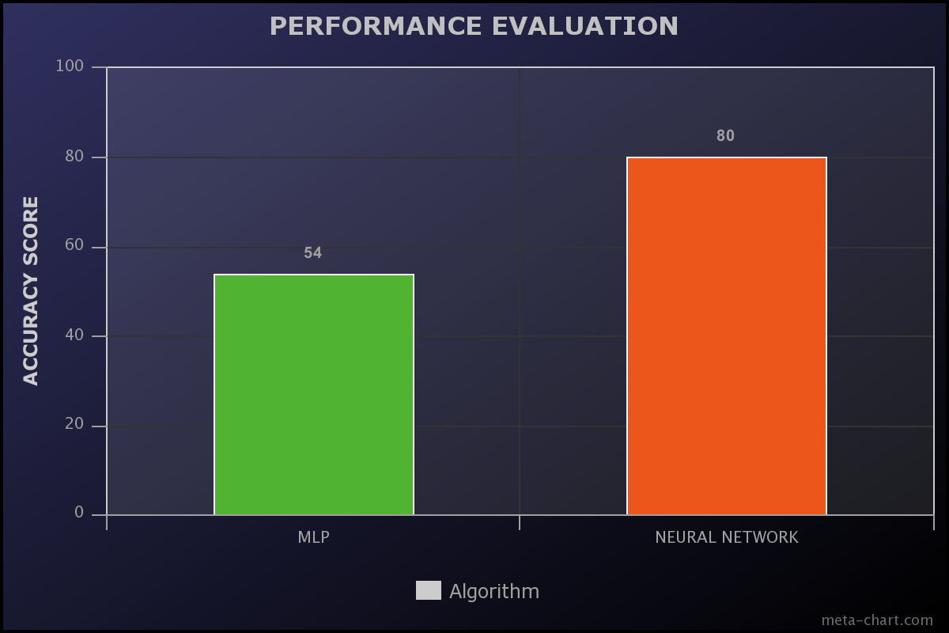
PERFORMANCE EVALUATION
MLP Classifier and neural network algorithm has aN accuracy score of 54% and 80% respectively for emotion prediction

Slide 17
RESULTS

Slide 18
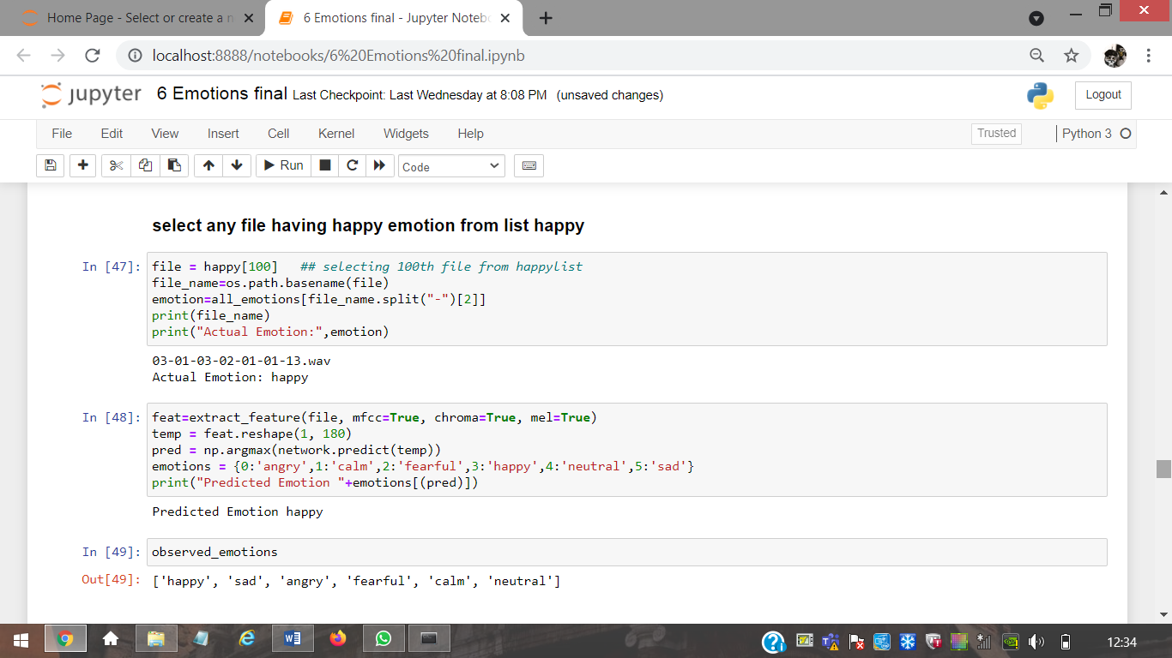
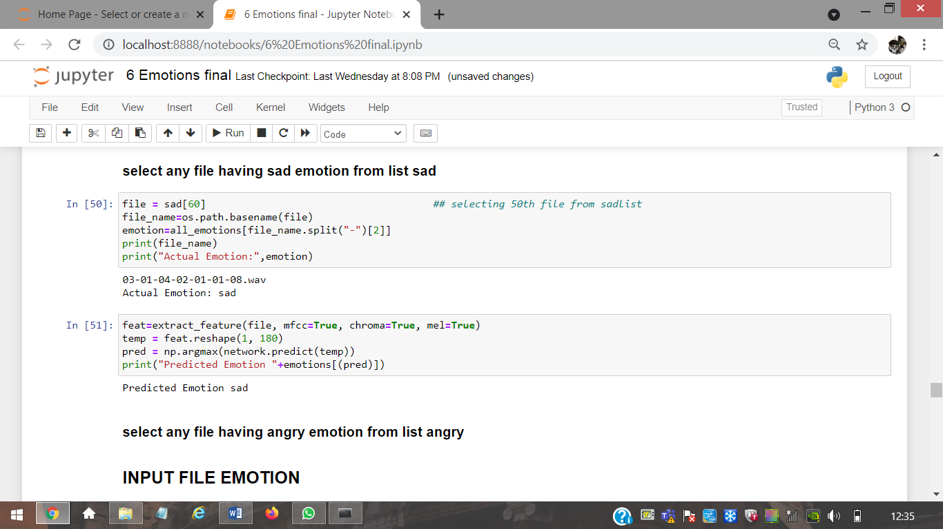
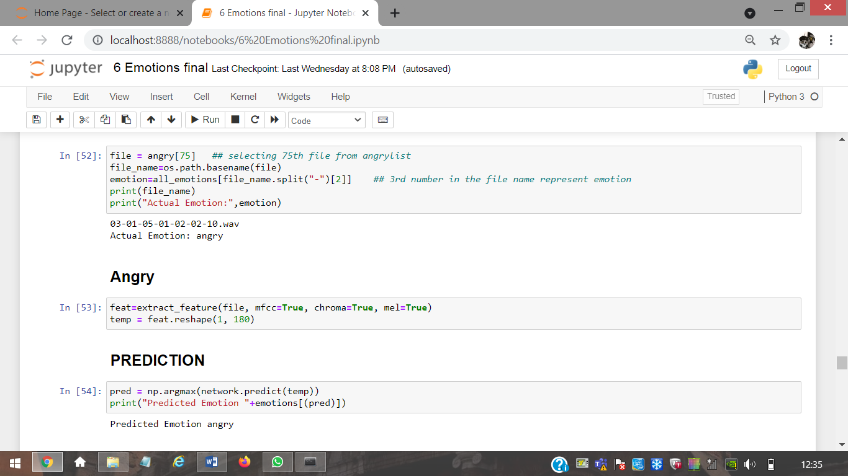
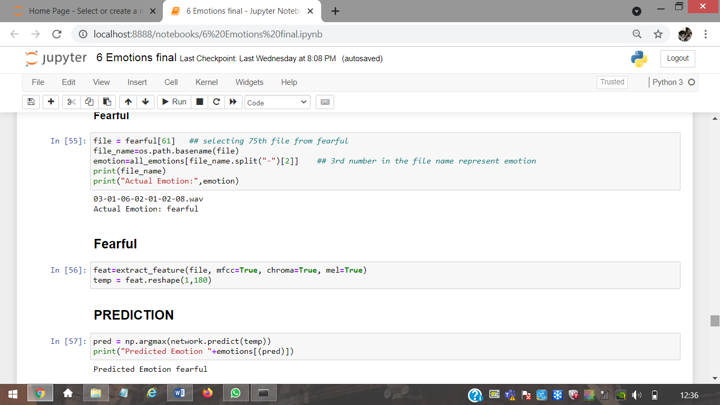
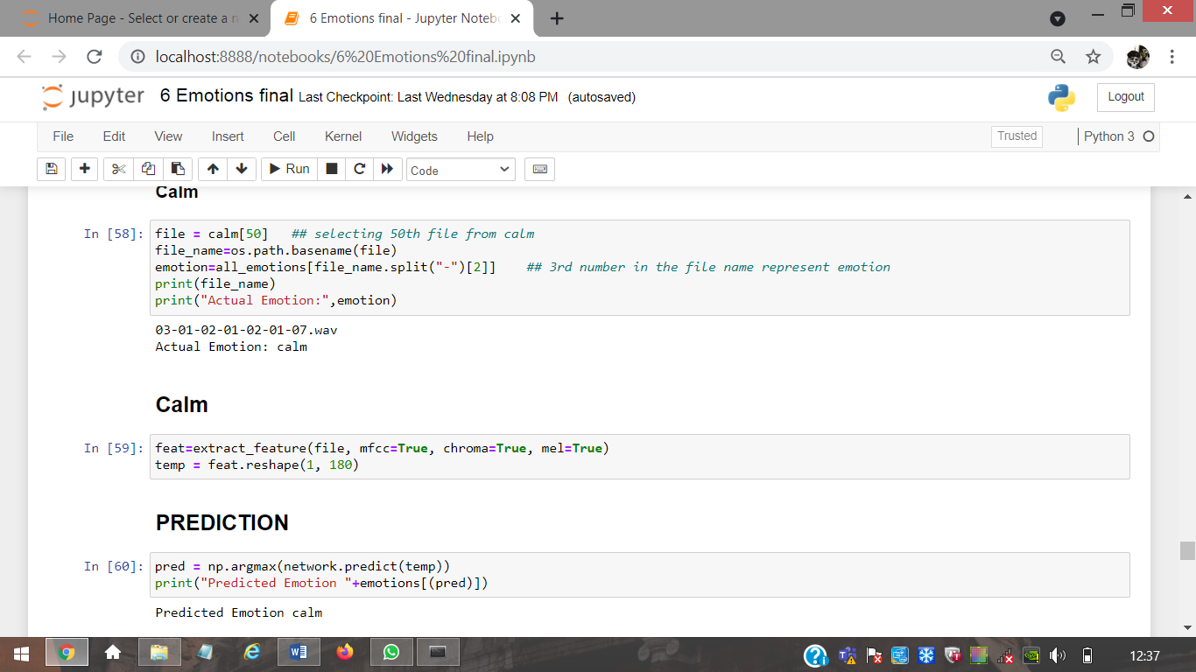
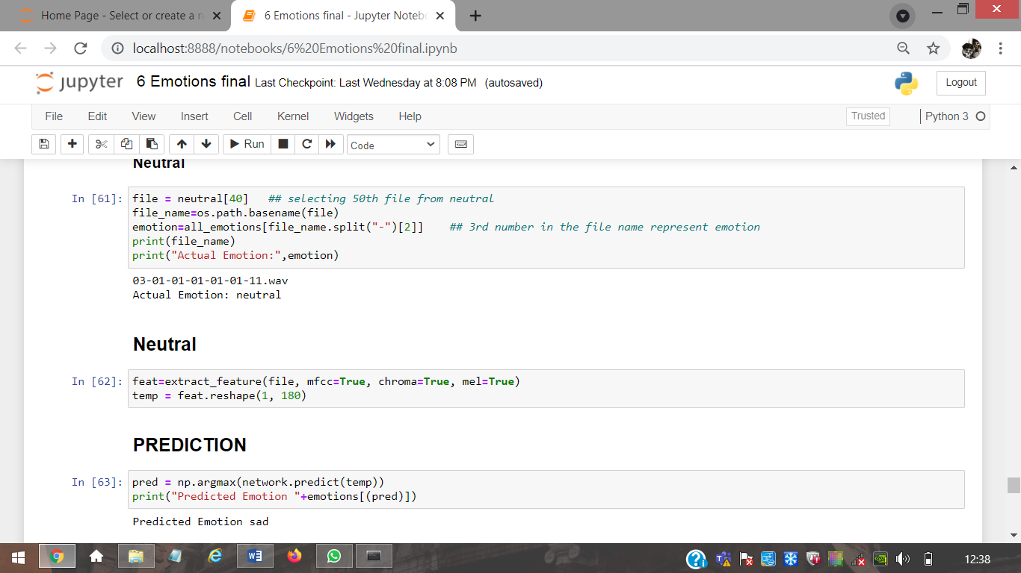
Neural network algorithm has aN accuracy score of 80 % for emotion prediction
That’s why we use this algorithm for emotion prediction for live audio

Slide 19
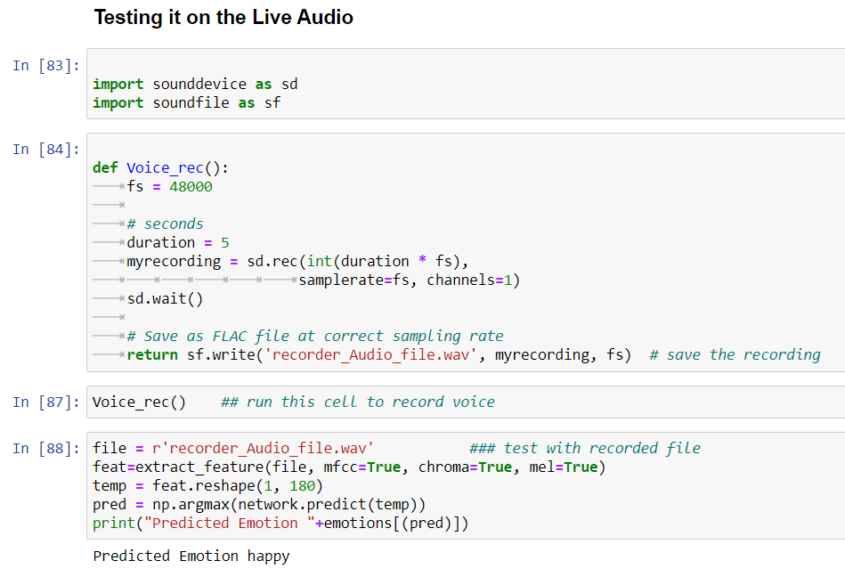
Our live audio demo had accuracy of 80% where 4 out of 5 times it predicted the right emotion

Slide 20
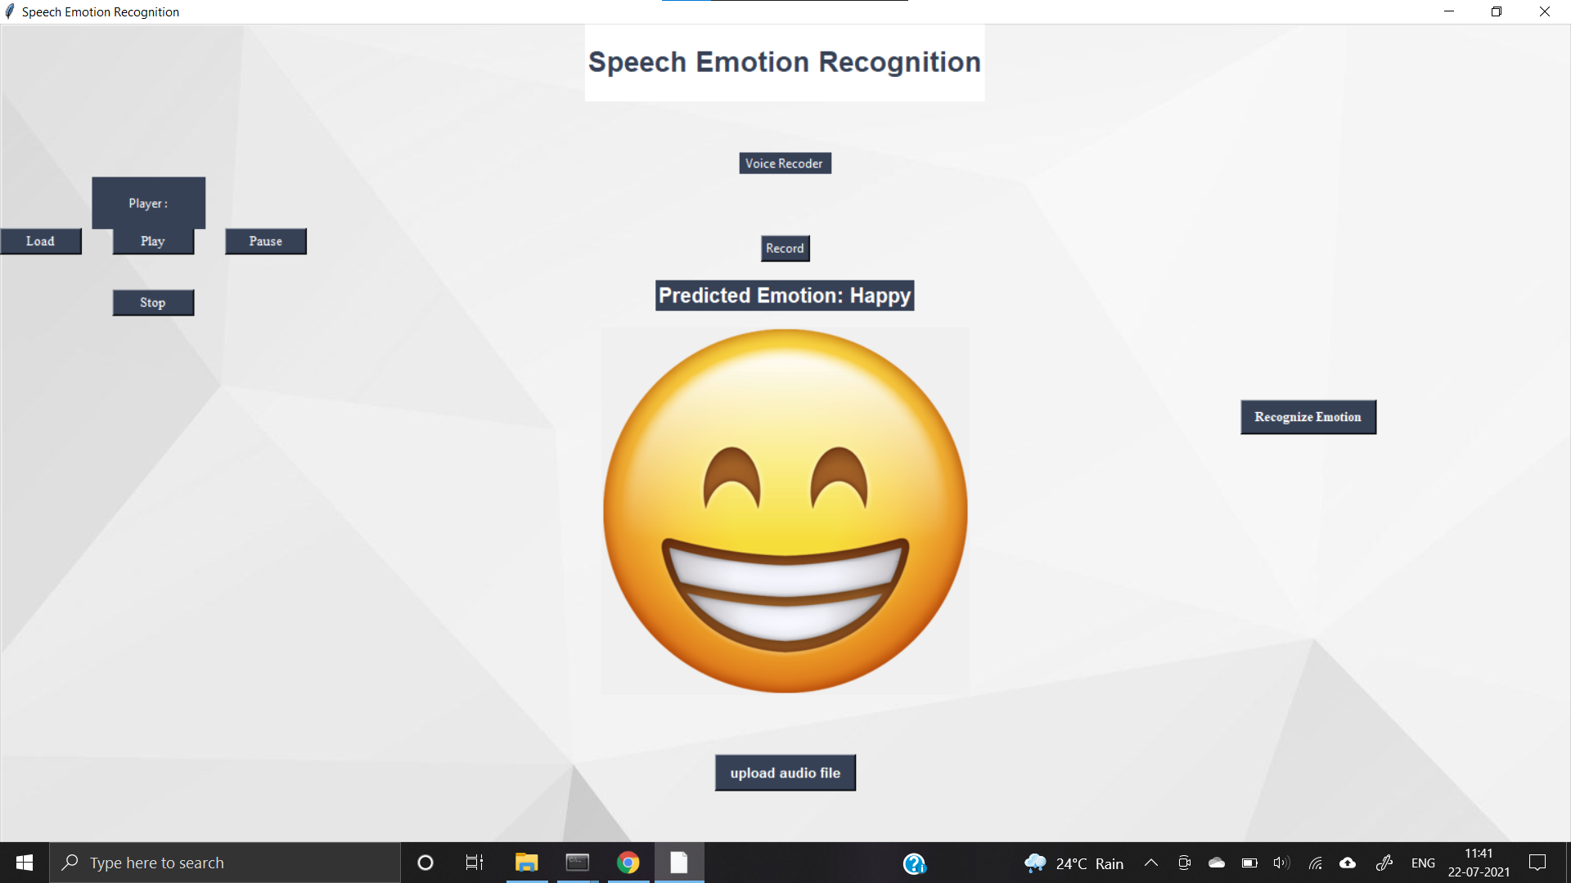

Slide 21
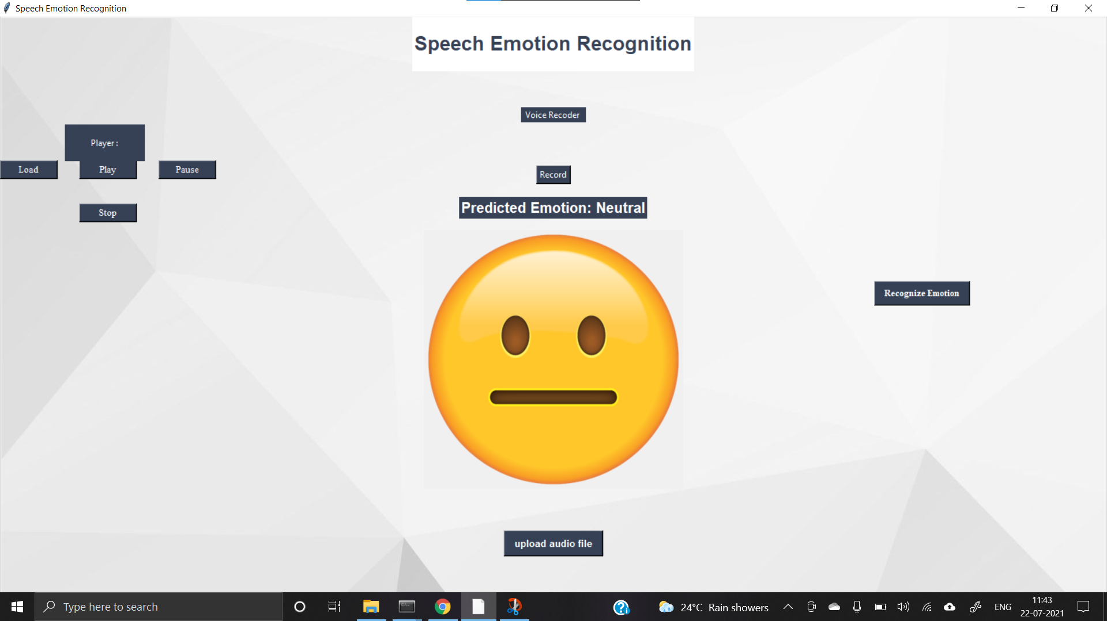

Slide 22
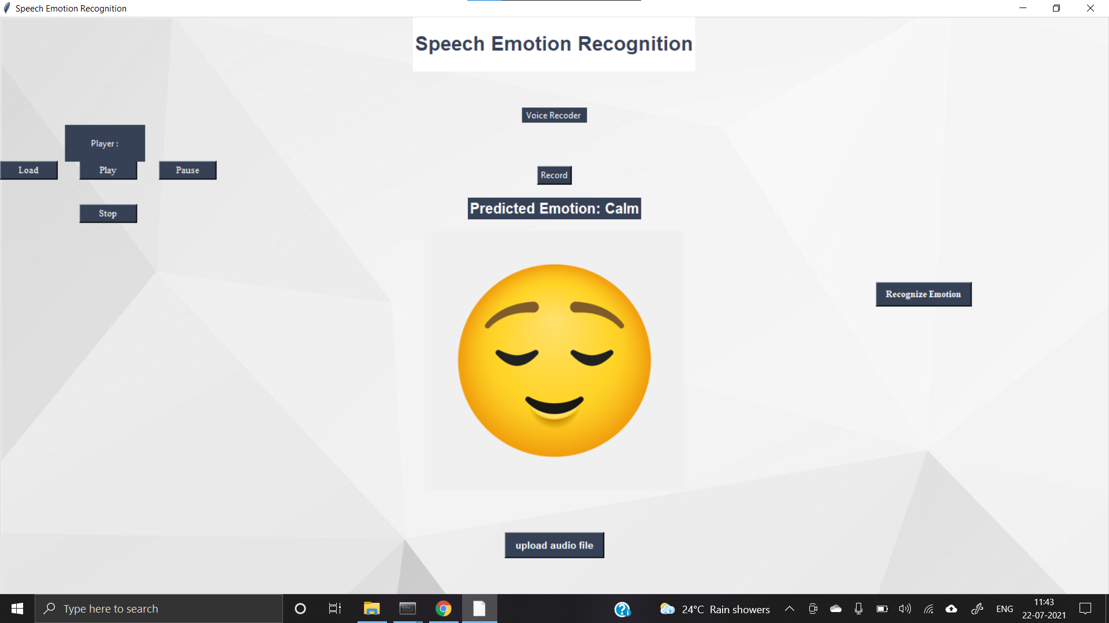

Slide 23
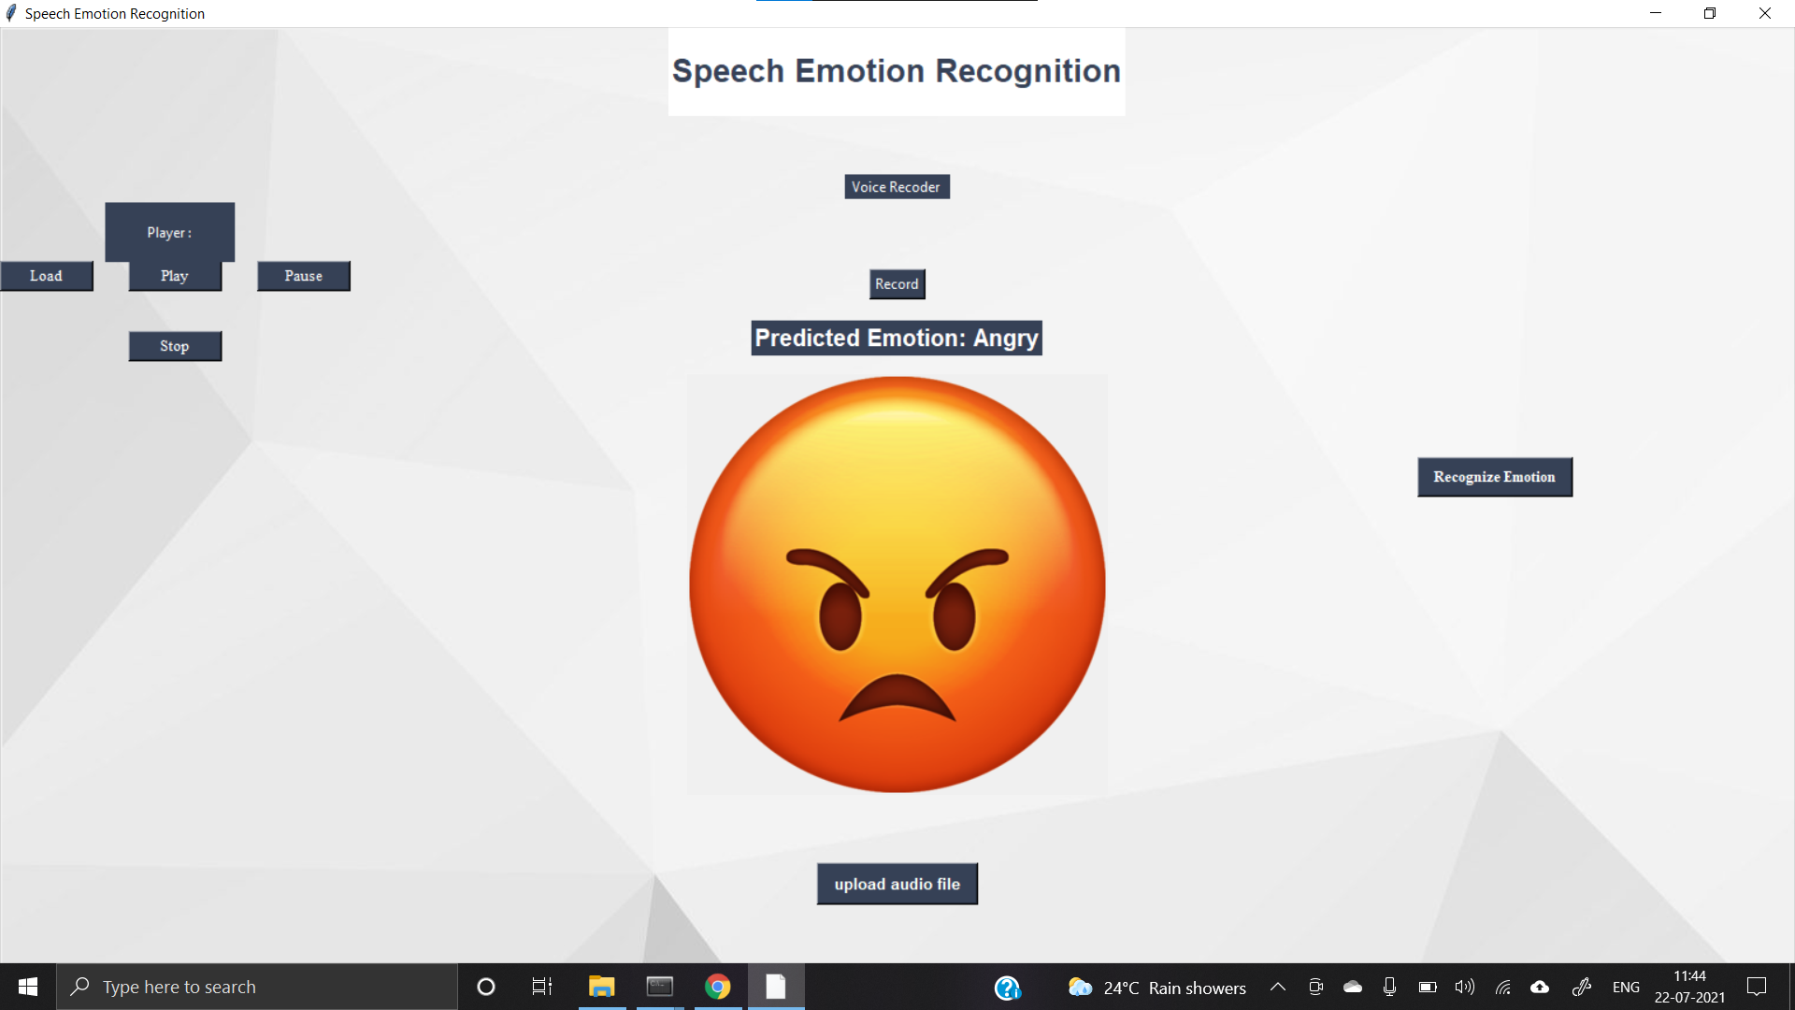

Slide 24
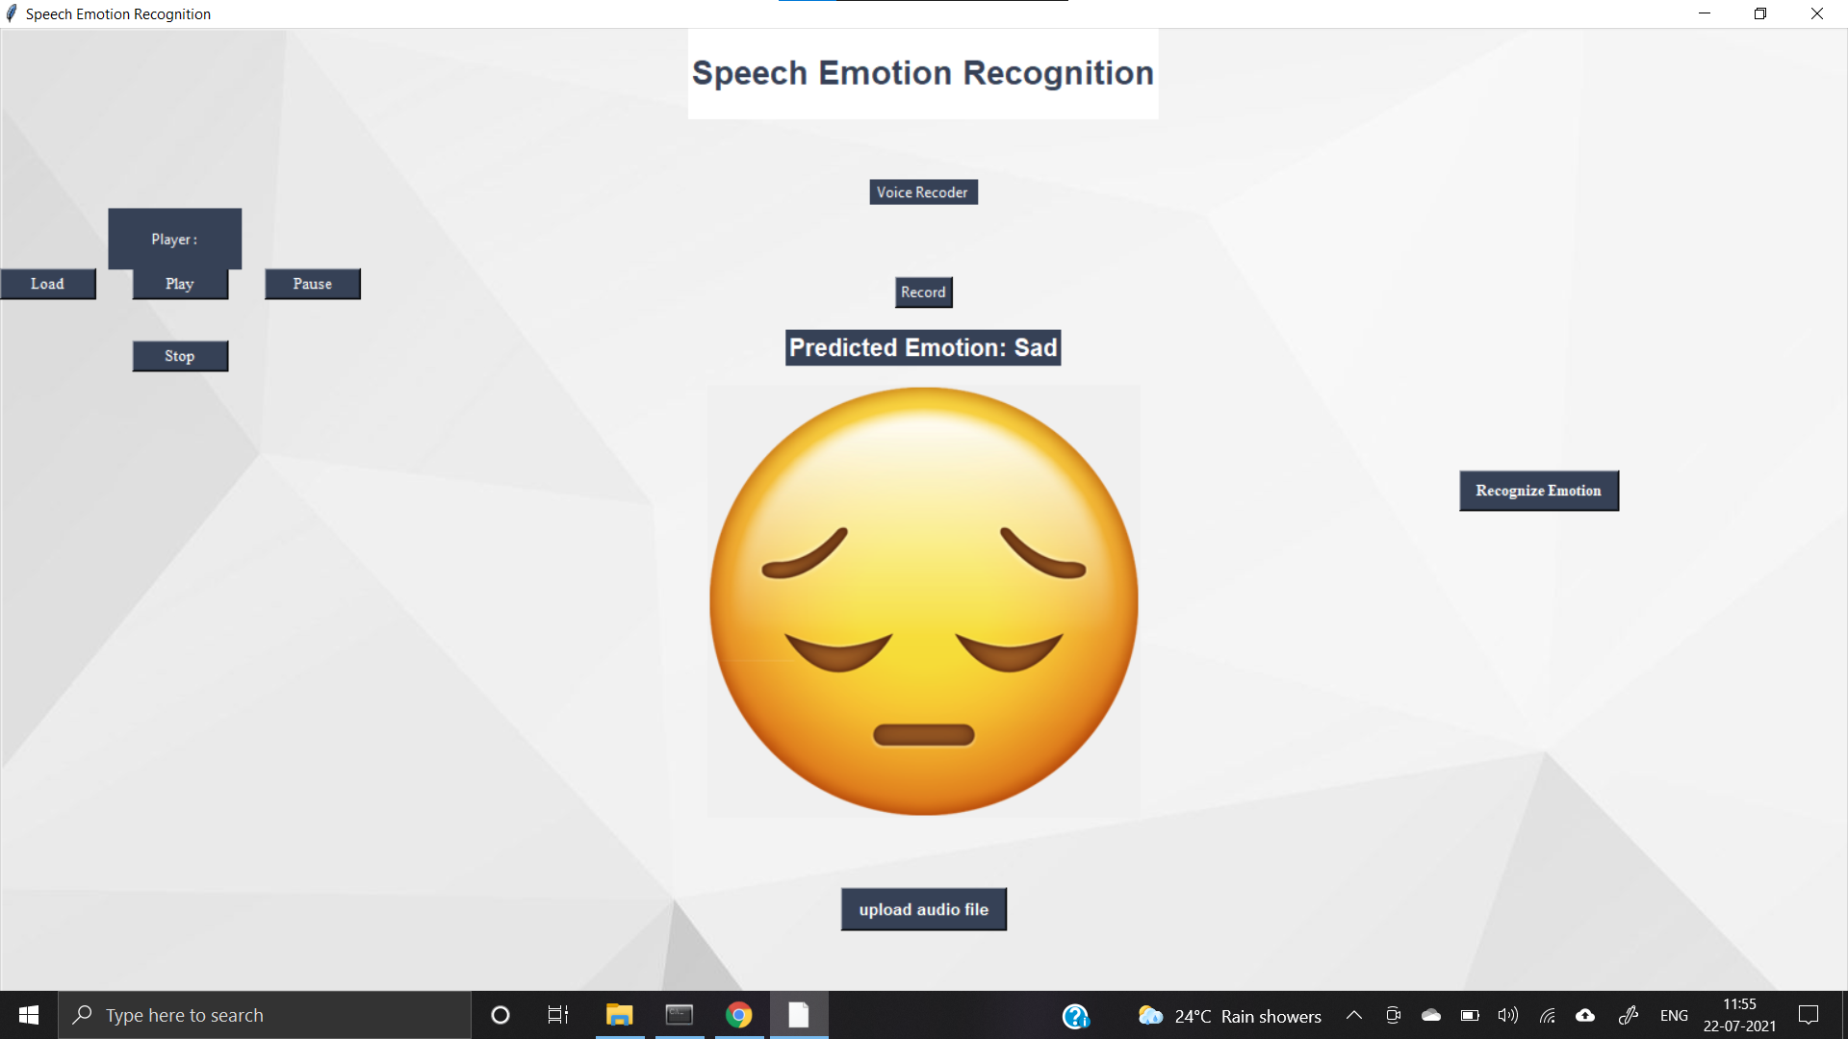

Slide 25
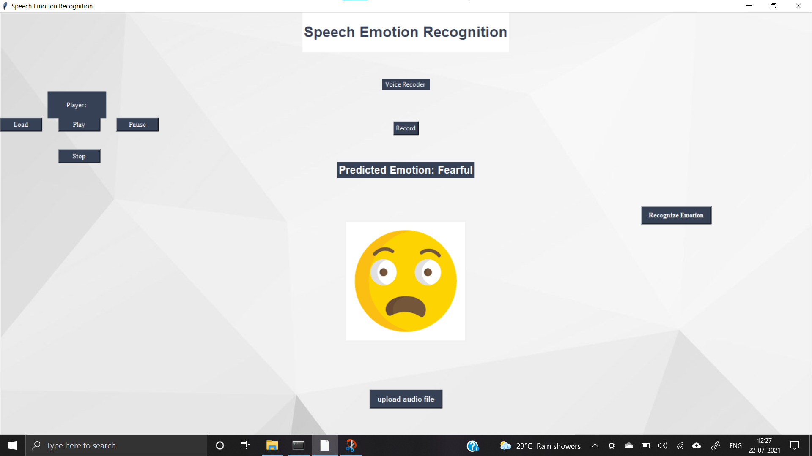

Slide 26
Automatic emotion recognitions from the human speech are increasing now a day because it results in the better interactions between human and machine. To improve the emotion recognition process, combinations of the given methods can be derived. Also by extracting more effective features of speech, accuracy of the speech emotion recognition system can be enhanced.
CONCLUSION

Slide 27
REFERENCES
M. S. Likitha , S. R. R. Gupta, K. Hasitha and A. U. Raju"Speech based human emotion recognition using MFCC." 2017 International Conference on Wireless Communications, Signal Processing and Networking (WiSPNET), Chennai, 2017, pp. 2257-2260.
Chen, S.H. and Y.R. Luo (2009), “Speaker Verification Using MFCC and Support Vector Machine,” in Proceedings of the International Multiconference of Engineers and Computer Scientists, March 18 - 20, 2009, Vol I IMECS 2009.
Livingstone SR, Russo FA (2018) The Ryerson Audiovisual Database of Emotional Speech and Song (RAVDESS): A dynamic, multimodal set of facial and vocal expressions in North American English. PLoS ONE 13(5): e0196391. https://doi.org/10.1371/journal.pone.0196391.
Thomas Zawistowski & Paras Shah, “An Introduction to Sampling Theory.” Internet: http://www2.egr.uh.edu/~glover/applets/Sampling/Sampling.html, [Feb.24, 2019].

Slide 28
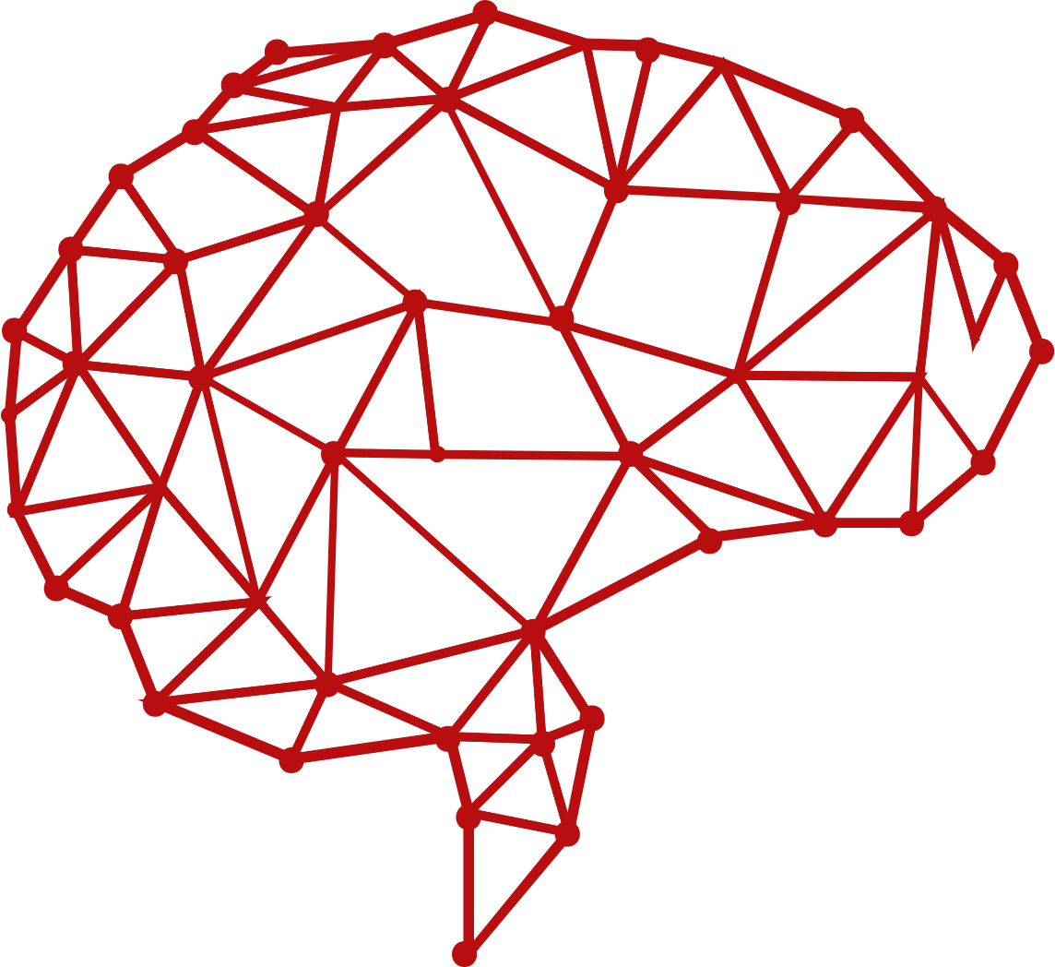
THANK YOU…!

